Slide 1
Group By & Aggregates in SQL
SQL Day 3 class

Slide 2
Learning Objectives
By the end of this lesson, you will be able to:
Understand the purpose of the GROUP BY clause.
Apply common aggregate functions like SUM(), AVG(), COUNT(), MAX(), and MIN().
Use aliases to improve query readability.
Differentiate between WHERE and HAVING clauses.
Notes:
Speaker Notes:
In this lesson, we'll explore the essential concepts of grouping and aggregation in SQL. Using the GROUP BY clause, we can organize data into meaningful groups, allowing us to perform calculations on these groups rather than individual records.
By the end of this session, you will have a solid understanding of how to use GROUP BY with aggregate functions like SUM(), AVG(), COUNT(), MAX(), and MIN(). You'll also learn how to apply aliases to make your query results more readable and how to differentiate between the WHERE and HAVING clauses for effective data filtering.
These skills are crucial for data analysis and reporting, enabling you to derive valuable insights from your datasets. Let's get started!

Slide 3
Using the Group By Clause
Purpose: GROUP BY is used to group rows that have the same values in specified columns into summary rows
like "total sales per department" or "average salary per job title."
Basic syntax:
SELECT column1, column2, AGGREGATE_FUNCTION(column3)
FROM table_name
GROUP BY column1, column2;
Examples:
GROUP BY CustomerID, OrderYear
GROUP BY Region, COUNTRY(Location)
Notes:
[Speaker Note:]
The GROUP BY clause is a fundamental part of SQL that allows you to organize data into groups based on one or more columns.
This is especially useful for generating summary statistics and insights from your data.
By grouping rows with the same values in specified columns, you can create summary rows that provide a higher-level view of your data.
Common use cases include calculating total sales per department, average salary per job title, or the number of orders per customer.

Slide 4
Using the Group By Clause
Grouping by Customer and Year:
Suppose you have a table Orders with columns CustomerID, OrderDate, and TotalAmount. You want to find the total amount spent by each customer per year:
SELECT CustomerID,
YEAR(OrderDate) AS OrderYear,
SUM(TotalAmount) AS TotalSpent
FROM Orders
GROUP BY CustomerID, YEAR(OrderDate);
Notes:
[Speaker Note:]
This query groups the data by CustomerID and the year extracted from OrderDate, calculating the total spending for each customer per year.

Slide 5
Using the Group By Clause
Grouping by Region and Country:
Consider a table Locations with columns Region and Location. You want to count the number of locations in each region and country:
SELECT Region,
Country,
COUNT(*) AS LocationCount
FROM Locations
GROUP BY Region, COUNTRY;
Notes:
[Speaker Note:]
This query groups the data by CustomerID and the year extracted from OrderDate, calculating the total spending for each customer per year.

Slide 6
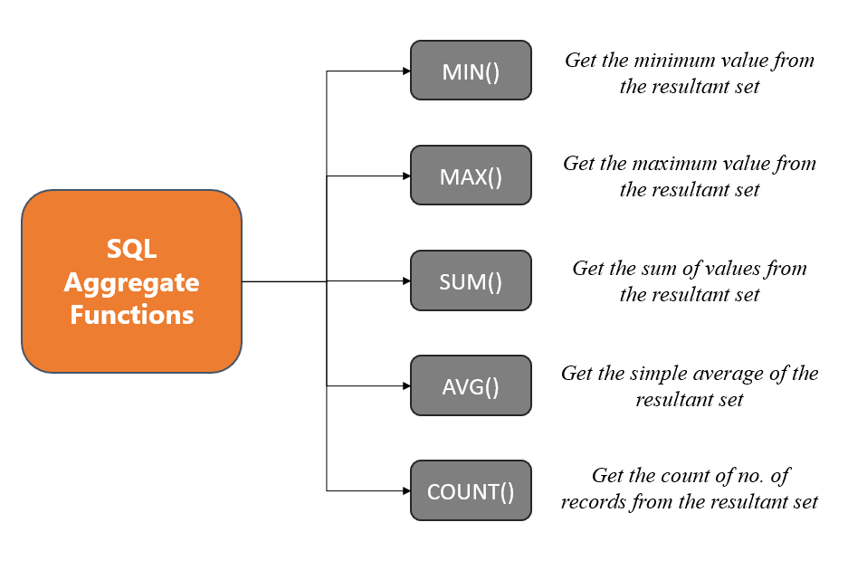
What is an Aggregate
When using GROUP BY, you often apply aggregate functions to perform calculations on each group. Here are some common aggregate functions:
Notes:
Speaker Notes:
Aggregates in SQL are powerful tools that allow us to summarize and analyze data effectively. They take multiple data points and transform them into meaningful statistics, providing a clearer picture of the data's characteristics.
Instead of dealing with individual records, aggregates help us consolidate and extract valuable insights from our datasets. Whether you need to calculate averages, find totals, identify minimum and maximum values, or even concatenate strings, aggregates offer a versatile set of functions.
One of the key advantages of aggregates is their ability to operate on groups within a table. This means you can analyze subsets of your data, making it particularly useful for comparing different categories or segments and gaining deeper insights into your data. So, let's delve further into these aggregate functions and see how they can unlock valuable insights in SQL.

Slide 7
Common Aggregate Functions
SUM(): Totals values in a column, useful for running totals, summing money, or aggregating quantities.
Example: SUM(sales) calculates total sales.
AVG(): Calculates the average of values in a column, offering a measure of central tendency.
Example: AVG(test_scores) finds the average test score.
Notes:
[Speaker Note:]
SUM() and AVG() are fundamental tools for handling numerical data. SUM() helps you calculate totals, such as total sales, while AVG() provides a measure of central tendency, like the average test score. These functions are essential for gaining insights and understanding the distribution of your data.

Slide 8
Common Aggregate Functions
MIN(): Locates the minimum value in a column, helpful for determining value ranges and extremes.
Example: MIN(expense) retrieves the lowest expense amount.
MAX(): Identifies the maximum value in a column, aiding in understanding value ranges and extremes.
Example: MAX(revenue) obtains the highest revenue.
Notes:
Speaker Notes:
MIN() and MAX() are handy when you need to pinpoint the smallest or largest values in your data. MIN() helps you find the lowest expense amount, while MAX() helps you identify the highest revenue. These functions are essential for understanding data ranges and extremes, which can be critical for decision-making and analysis.

Slide 9
Common Aggregate Functions
COUNT(): Tallies the number of rows in a column, valuable for counting records, events, and more.
Example: COUNT(customers) calculates the total number of customers.
COUNT(DISTINCT): counts the number of unique values in a column, excluding duplicates.
Example: COUNT(DISTINCT products) gives you the count of distinct product names.
Notes:
[Speaker Note:]
While COUNT() is great for straightforward row counting, COUNT(DISTINCT) takes it a step further by providing the count of unique values in a column.
In the example, COUNT(DISTINCT products) would give you the number of different product names, eliminating duplicates for more precise analysis.
These functions are valuable tools for understanding data volume and uniqueness.

Slide 10
Using Aliases with Aggregates
Aliases: Valuable for renaming aggregate columns in queries, by enhancing column name readability.
Syntax:
AGGREGATE_FUNCTION(column) AS Alias_Name
to create aliases for columns.
Example: In the SQL statement:
SELECT
ProductCategory,
AVG(OrderValue) AS AvgOrdVal
FROM Sales.SalesOrderHeader;
GROUP BY ProductCategory;
Notes:
Speaker Notes:
When working with aggregate functions in SQL, aliases become an essential tool for simplifying column names and making the output more readable and user-friendly.
The syntax for creating aliases is straightforward: AGGREGATE_FUNCTION(column) AS alias_name. This allows you to assign a custom name to the result of an aggregate function applied to a column.
Let's take a look at an example to illustrate the power of aliases.
Here, we've used alias "AvgOrdVal" to replace the default column names. This makes it crystal clear that we are calculating the total sales and average line total, improving the understanding of the query's purpose.
As we move forward, we'll explore more scenarios where column aliases can simplify complex queries and help you present your data in a more organized and comprehensible manner.

Slide 11
Using the HAVING Clause
You can think of the HAVING clause as a filter for groups, similar to how the WHERE clause filters individual rows.
Key Differences from WHERE:
WHERE: filters rows before aggregation.
HAVING: filters groups after aggregation.
Syntax:
SELECT group_columns, aggregates
FROM table
GROUP BY grouping_columns
HAVING conditional_check;
Notes:
[Speaker Note:]
The HAVING clause in SQL allows you to filter the results of a query based on aggregate conditions applied after the GROUP BY operation.
It's important to understand the key differences between WHERE and HAVING, as WHERE filters rows before aggregation, while HAVING filters groups after aggregation.
This clause is essential for refining and focusing your grouped results.

Slide 12
Using the HAVING Clause
Example Using HAVING:
SELECT year, SUM(sales) AS TotalsSales
FROM data
GROUP BY year
HAVING SUM(sales) > 1000;
In contrast, if you wanted to filter individual sales records before grouping, you would use a WHERE clause:
SELECT year, SUM(sales) AS TotalsSales
FROM data
Where sales > 100
GROUP BY year
Notes:
[Speaker Note:]
This SQL example demonstrates how the HAVING clause is used to filter and focus on groups with total sales exceeding 1,000,000 units.
It's a valuable tool for narrowing down your analysis to specific subsets of data based on aggregate conditions.

Slide 13
Using the HAVING Clause
Tips:
Filter Groups: Use HAVING to focus on groups that meet specific aggregate conditions.
Targeted Analysis: Apply HAVING to refine your results by including only groups that satisfy certain criteria.
Limitations:
Post-Aggregation: HAVING works only after data is grouped and aggregated, not on individual rows.
Aggregate-Specific: It's meant for filtering based on aggregate calculations, not individual row conditions.
Notes:
[Speaker Note:]
The HAVING clause is a valuable SQL tool for filtering and refining grouped data based on aggregate conditions.
However, it has some limitations, such as operating on aggregated results and potential performance considerations when dealing with complex conditions.
Understanding these tips and limitations will help you use HAVING effectively in your data analysis.

Slide 14
Using Aliases with Aggregates
Order of Operations in SQL:
FROM
JOIN
WHERE
GROUP
Aggregate Functions
SELECT Clause
HAVING Clause
ORDER BY Clause
Notes:
[Speaker Note:]
Understanding the order of operations in SQL is crucial for constructing effective queries and ensuring accurate results.

Slide 15
Order of Operations
FROM Clause: The query begins by identifying the data source
JOINs: If there are any joins, they are processed next,
WHERE Clause: This filters rows based on specified conditions before any grouping or aggregation occurs.
GROUP BY Clause: After filtering, the GROUP BY clause organizes the data into groups based on one or more columns.
Aggregate Functions: Aggregate functions are applied to the grouped data to perform calculations.
Notes:
[Speaker Note:]

Slide 16
Order of Operations
SELECT Clause: This is where aliases are typically used. After the data is grouped and aggregated, you can assign aliases to the results of aggregate functions for clarity and readability.
HAVING Clause: This filters groups based on conditions applied to the aggregated results
ORDER BY Clause: Finally, the ORDER BY clause sorts the result set based on one or more columns, which can include aliases.
Notes:
[Speaker Note:]

Slide 17
Summary
GROUP BY:
GROUP BY categorizes rows into groups to apply aggregates per group. This segments the data to show aggregates by categories.
Aggregates:
Aggregates perform calculations across rows of data to produce summarized results.
HAVING:
HAVING enables filtering group results by aggregate criteria to focus on significant groups. It is the aggregation equivalent of WHERE.
Notes:
[Speaker Note:]
Aggregates, GROUP BY, HAVING, and ORDER BY are powerful SQL components that work in tandem to help you gain deeper insights into your data.
They allow you to perform calculations, segment data into meaningful groups, filter group results, and order your results for comprehensive data analysis and understanding.

Slide 18
Exercise
Open the Day 3 Exercise.sql file
Answer the questions from each section
Notes:
Answers are stored in the Exercise Answers.sql file

